Slide 1
Exceptional Handling
DR MANOJ VARSHNEY
ASST. PROFESSOR
T&D DEPT.
GLA UNIVERSITY, MATHURA

Slide 2
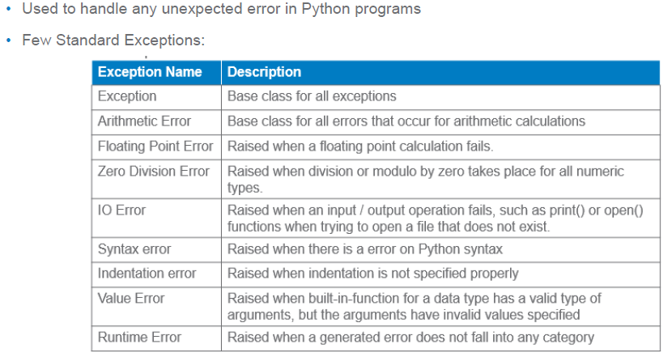

Slide 3
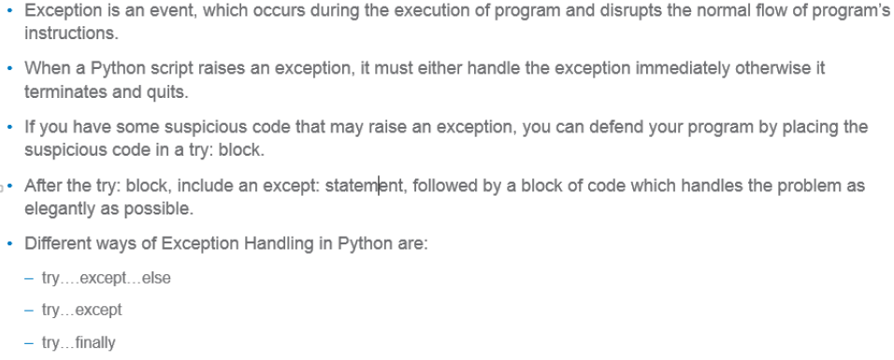
Handling an Exception

Slide 4
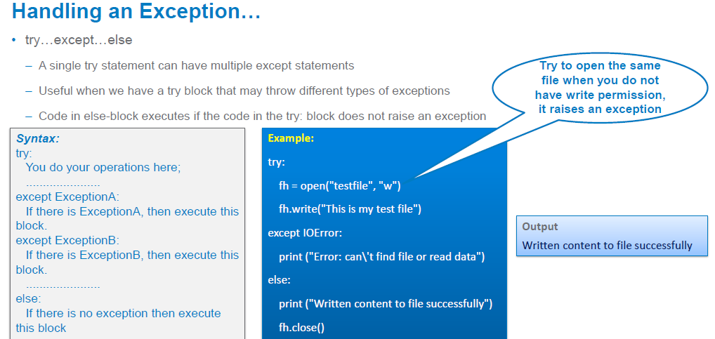

Slide 5
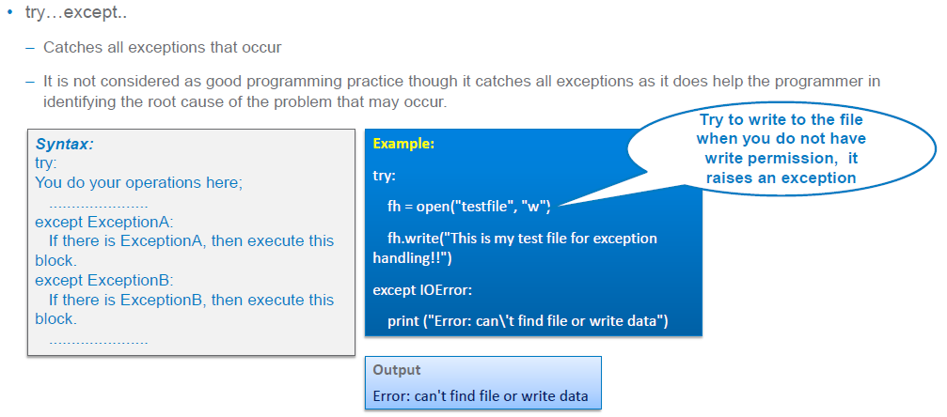

Slide 6
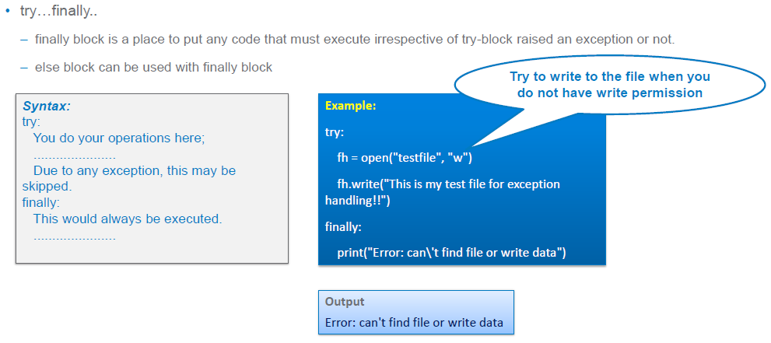

Slide 7
Multiple except blocks
try:
statement(s)
except Exception1:
statement
except Exception2:
statement
except Exception3:
statement

Slide 8
Multiple Exceptions in a Single except block
try:
n=int(input(‘Enter the number’))
print(n**2)
except (KeyboardInterrupt, ValueError,TypeError):
print(“Please Check before you enter”)
print(“Bye”)

Slide 9
1. ZeroDivisionError
a=int(input(‘Enter the number’))
b=int(input(‘Enter the number’))
try:
c=a/b
print(c)
except ZeroDivisionError as e:
print(“Please Check Denominator ”,e)
print(“Bye”)

Slide 10
2. ValueError
try:
n=int(input(‘Enter the number’))
print(n**2)
except ValueError as e:
print(“Please Check before you enter ”,e)
print(“Bye”)

Slide 11
3.KeyboardInterrupt
try:
n=int(input(‘Enter the number’))
print(n**2)
except KeyboardInterrupt as e:
print(“Do not press ctrl+c ”,e)
print(“Bye”)

Slide 12
4. TypeError
try:
n=int(input(‘Enter the number’))
print(n**2+’Hello’)
except TypeError as e:
print(“Please Check the datatype in expression”,e)
print(“Bye”)

Slide 13
5. FileNotFoundError
fname=input(“Enter the filename”)
try:
fp=open(fname,’r’)
print(fp.read())
except FileNotFoundError as e:
print(“Please Check before you enter ”,e)
print(“Bye”)

Slide 14
6. PermissionError
fname=input(“Enter the filename”)
try:
fp=open(fname,’w’)
fp.write(‘piyush’)
fp.close()
except PermissionError as e:
print(“Please Check the Permission of file ”,e)
print(“Bye”)

Slide 15
7. IndexError
L=[1,2,3,4]
try:
print(L[9])
except IndexError as e:
print(“Please Check the index ”,e)
print(“Bye”)

Slide 16
8.NameError
try:
print(a)
except NameError as e:
print(“Please Check the variable a ”,e)
print(“Bye”)

Slide 17
9. KeyError
D={1:1,2:8,3:27,4:64}
try:
print(D[5])
except KeyError as e:
print(“Please Check the key exists or not ”,e)
print(“Bye”)

Slide 18
Raising Exceptions
We can deliberately raise an exception using the raise keyword
Syntax
raise [Exception [args]]
Example:
try:
n=10
print(n)
raise ValueError
except:
print(“Exception Occurred”)

Slide 19
Re-raise an Exception
try:
raise NameError
except:
print(“Re-raising the exception”)
raise

Slide 20
Handling Exceptions in Invoked Functions
def fun(a,b):
try:
c=a/b
except ZeroDivisionError:
print(“You can not divide a no. by zero”)
a=int(input(“Enter the Number”))
b=int(input(“Enter the Number”))
fun(a,b)

Slide 21
def fun(a,b):
return a/b
a=int(input(“Enter the Number”))
b=int(input(“Enter the Number”))
try:
fun(a,b)
except ZeroDivisionError:
print(“You can not divide a no bye Zero”)

Slide 22
Programs
WAP that prompts the user to enter a number. If the number is positive or zero, print it, otherwise raise an exception ValueError with some message.
WAP which infinitely print natural numbers. Raise the StopIteration exception after displaying first 20 numbers to exit from the program.
WAP that prompts the user to enter his name. The program then greets the person with his name. But if the person’s name is “Rahul”, an exception is thrown explicitly and he is asked to quit the program.

Slide 23
Tricky Questions (Code 1)
1. What will be the output?
def fun():
try:
print("Hello")
return 1
finally:
print("DONE")
fun()
print("Hi")

Slide 24
2. What will be the output?
def fun():
for i in range(5):
try:
if i==0:
print("Hello")
break
finally:
print("DONE")
fun()
print("Hi")

Slide 25
3. What will be the output?
def fun():
for i in range(5):
try:
if i==0:
print("Hello")
continue
finally:
print("DONE")
fun()
print("Hi")

